Slide 1
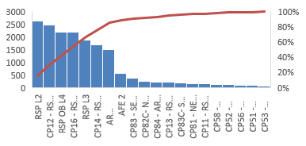
Global RME Jam Program
SYR1 Jam Analysis Jun 1 – Aug 31 (2024)
Analyzing a small sample from (Jun 1 – Aug 31) the top five (5) equipment subareas with the highest OEE faulted hours were, ARSTOW, PACKLINE, AR FIELD, ARSAW and RECEIVE. The top five (5) Alarm faults matched the subarea presented by the OEE dashboard, with a slight higher alarm indications. As seen on table 1 and chart 1. (Reference Appendix page 2 & 3)
When analyzing the total volume of units and comparing to SEV/HIE events, the amount of incidents reported is in correlation to the sites total volume that get’s processed in those areas. In particularly, the AR INFEED, SHIP area had the most volume which correlates to the highest incidents area. (Reference Appendix page 5 & 6)
Safety Incident: An AA experience an injury on July 21, 2024 while working on the stow station 2317. A tote came onto the back of the sled at a slant, becoming stuck. While attempting to unjam the tote they felt a sharp pain in their right shoulder and lower back. (Reference Appendix page 7)
Vital Few
Useful Many
Top 5 Subarea | Faulted Hrs.
ARSTOW | 14008
PACKLINE | 1700
AR FIELD | 1621
ARSAW | 1407
RECEIVE | 714
Faulted Hours Chart
Alarm Faults Pareto
Area | Total Units
SHIP | 1,071,852,002
AFE 1 | 336,319,884
AFE 2 | 241,275,028
RSP | 107,261,488
PACK | 82,246,785
Top 5 Equipment | SEV/HIE Events
AR INFEED | 22
SHIP | 8
AFE 1 | 5
AR RCV | 4
AR ARSAW | 3
SEV Events Chart
Throughput Chart
Take Action
Physical site audit will be conducted on October 8 and October 9
Audit the 5 (ARSTOW, PACKLINE, AR FIELD, ARSAW and RECEIVE) area/subarea of faulted hrs. by Jam
Conduct the 6 Jam PCA verification of completion (Reference Appendix page 8)
4 Best Practices has been identified to support the site with Jam reduction (Reference Appendix page 8)
Conduct a brief closing meeting of the physical audit with all follow ups (if any)
Physical site audit of the STOW STATION (Incident Reported)
Verify that area is clean of labels and that RME is consistent with PM maintenance (Reference Appendix page 7)
3 Months of Program Management support for the site
Goal to focus on the top 5 faulted problem areas (use the 80-20 rule)
Come up with actions to support site with faulted problem areas
Virtual SYR1 Jam Support chime group will be created. The purpose of the group will be to support SYR1 and add any additional support teams to help the site improve
Biweekly meetings will be established for site support and progress updates

Slide 2
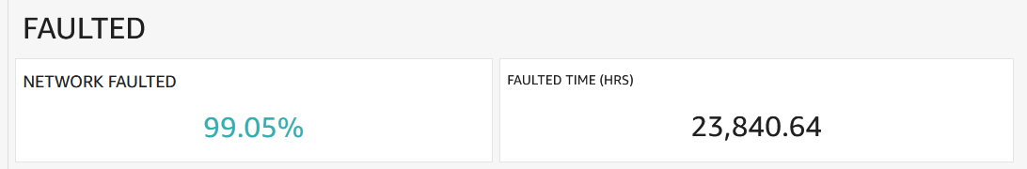
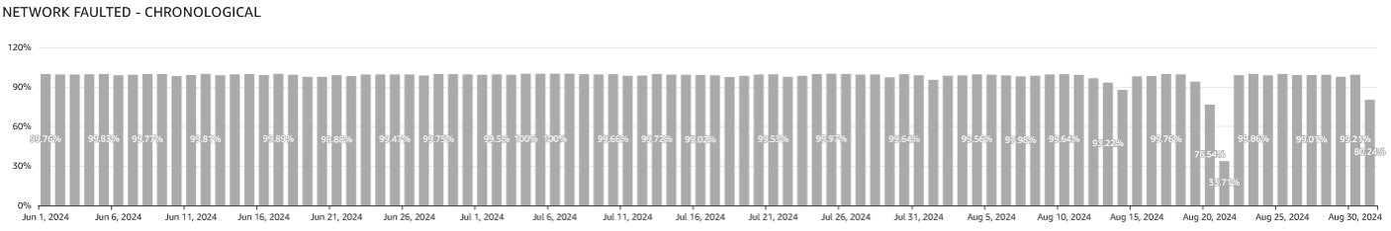
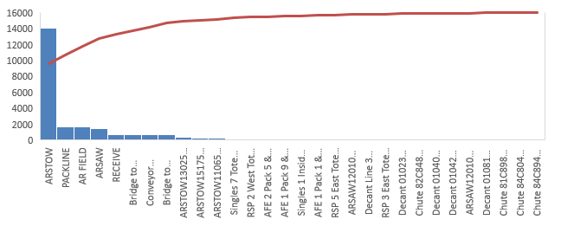
Appendix
OEE Faulted (Jams)
Top 5 Subarea | Faulted Hrs.
ARSTOW | 14008
PACKLINE | 1700
AR FIELD | 1621
ARSAW | 1407
RECEIVE | 714

Slide 3
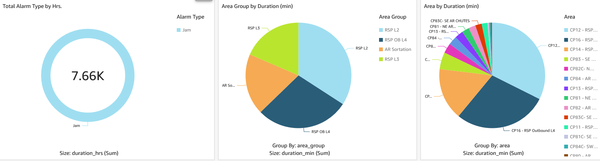
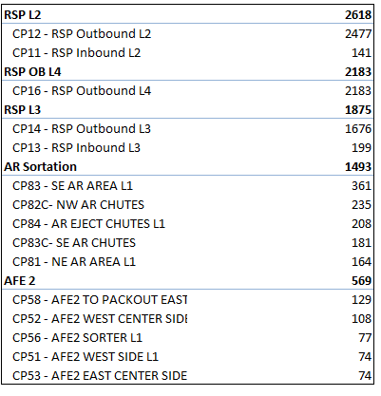
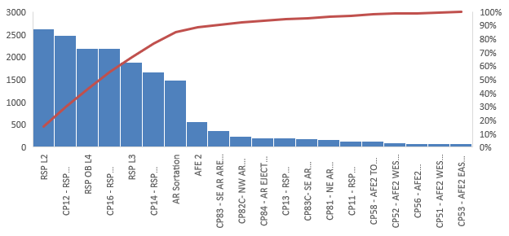
Appendix
Alarms Faults
Top 5 Subarea | Fault Duration Hrs.
RSP L2 | 2618
RSP OB L4 | 2183
RSP L3 | 1875
AR Sortation | 1493
AFE 2 | 569

Slide 4
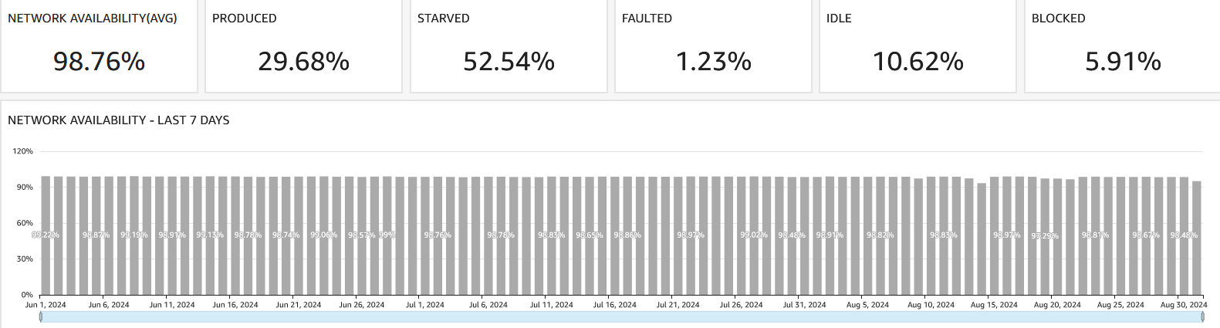
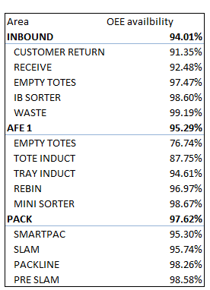
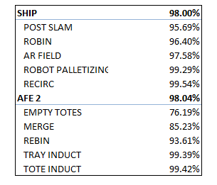
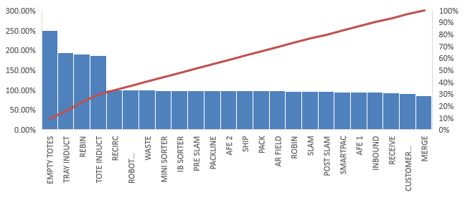
Appendix
OEE Availability
Top 5 Area | OEE Availability
INBOUND | 94.01%
AFE 1 | 95.29%
PACK | 97.62%
SHIP | 98.00%
AFE 2 | 98.04%

Slide 5
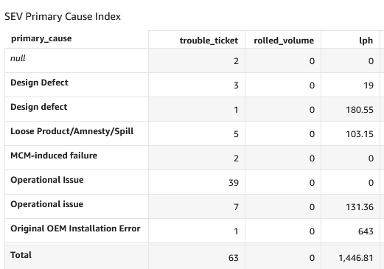
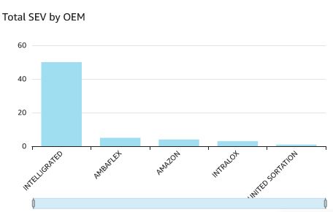
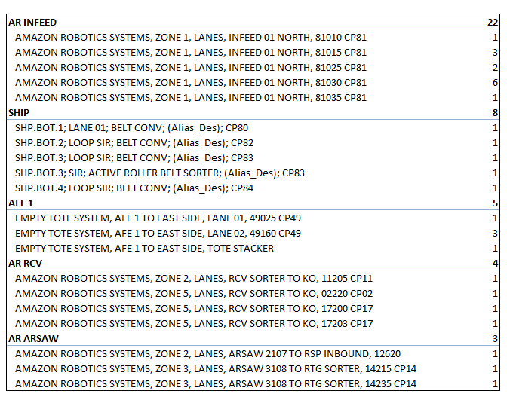
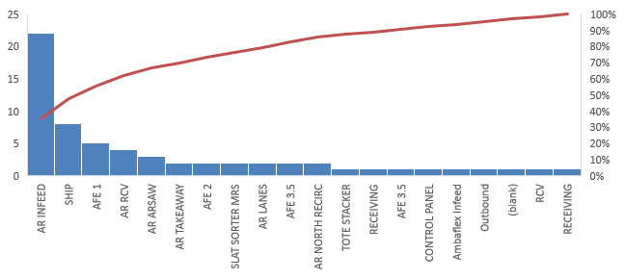
Appendix
SEV/HIE Events
Top 5 Equipment | SEV/HIE Events
AR INFEED | 22
SHIP | 8
AFE 1 | 5
AR RCV | 4
AR ARSAW | 3

Slide 6
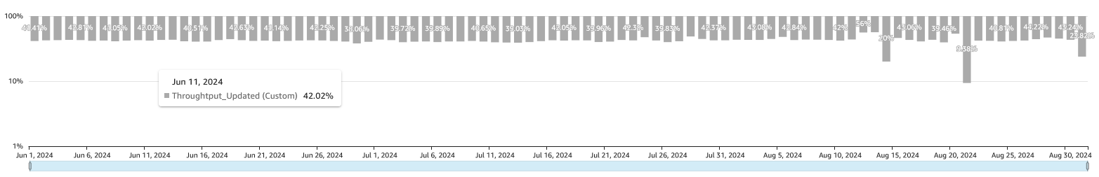
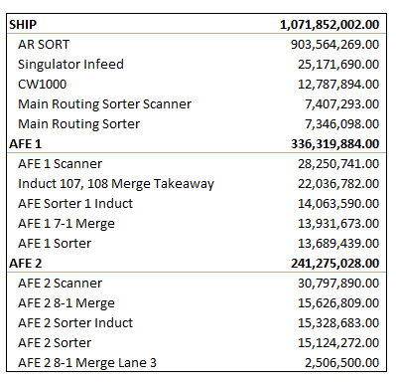
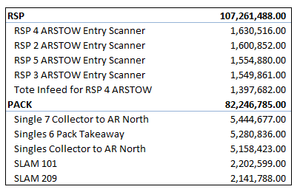
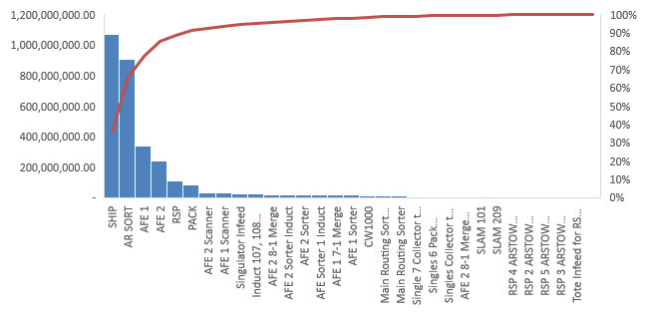
Appendix
Throughput Total Units (Site Volume)
Area | Total Units
SHIP | 1,071,852,002.00
AFE 1 | 336,319,884.00
AFE 2 | 241,275,028.00
RSP | 107,261,488.00
PACK | 82,246,785.00

Slide 7
Appendix
Safety Incidents
Case Number | Site | Date | Injury Location | Description
SYR1-24-1024 | SYR1 | Jul 21, 2024 | Stow Station | On 07/21/2024/at 8:55 AM an AA working in Stow suffered an injury to their lower back/right shoulder when AA said the tote came onto the back of the sled slanted becoming stuck so they attempted to unjam the tote to slide it down into the front of the sled and while doing so, felt a sharp pain in their right shoulder and discomfort in their lower back. . The AA reported for treatment on 07/21/2024 at 09:27 AM with 7/10 pain. Leadership was notified of the incident by the associate and proceeded to the treatment location. The AA received onsite treatment and returned to normal path. During the investigation, the AA stated they were following standard work at the time of the incident. At the time of the incident, the AA had been working in Stow, which is their home path, for 1 hour. The AA was hired on 06/27/2024 and works on the DL4-0700 shift. The AA was not working overtime at the time of the incident. The associate was not working in a path which requires job rotation. Job rotation was not found to be a contributing factor. The AA is trained in the path in which they were working at the time of the incident. The AA trained in Stow on 07/02/2024 using module # Nike Stow Day 3. Review of training material was conducted and deficiencies were not identified. Training was not found to be a contributing factor. The work area was reported by the associate as being organized at the time of the incident. The AA stated they were using the correct tools for the process. The correct tools for the process were available. The tools were found to be in safe working condition. Area readiness was not found to be a contributing factor. The AA was working with/near the following equipment: yellow tote at ARStow station 2317. The following deficiencies were found within the equipment: Tote came in at an angle onto back of sled getting stuck/wedged . Machinery and equipment were found to be a contributing factor. During the investigation, the AA stated that they were wearing the proper PPE for the task at the time of the injury.

Slide 8
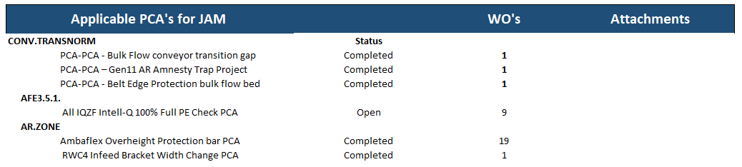
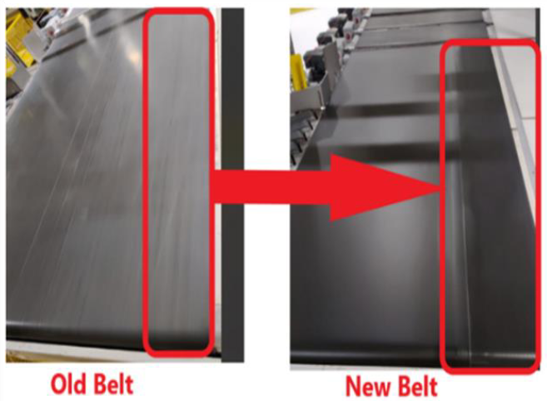
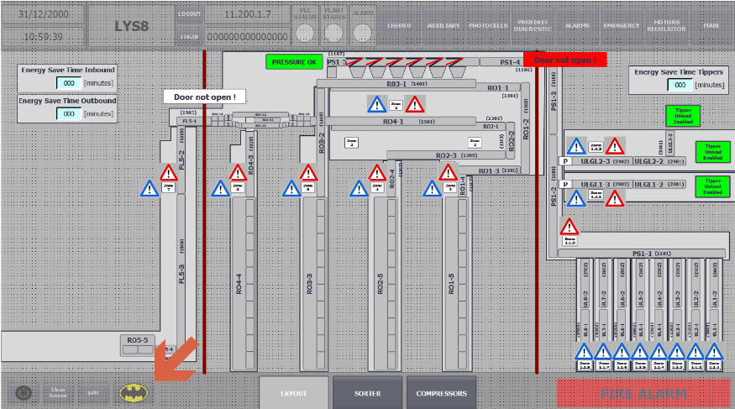
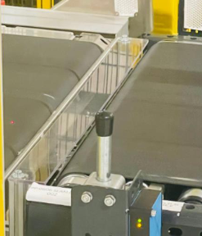
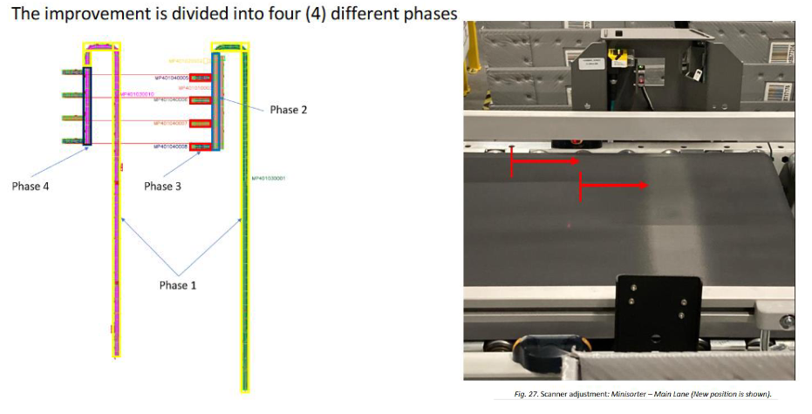
Appendix
Network Initiatives
The table below represents a total of applicable PCA’s for SYR1. JAM PCA’s accounted for 29% of overall PCA’s.
Potential Best Practice | Description | Image
Double Roughness Injector Belt | This best practice aims for the installation of a dual friction belt on the induct station of the site. The injector belt improves efficiency and reduce “JAM” caused by parcels sliding on the standard belt.
Transition Plate for Jam Detection | This project aims to detect stuck parcels between the transition plate and the belt. The detection starts as soon as the blockage happens, this allows for the prevention of any damage equipment
SLAM – HazMat Camera Cover | Introduction of new types of packages, SIOCs and SIOBs especially on Single Packs (small types of products) led to jams at the entrance of the Scale. After investigation it was figured out, that distance between Metering belt and the Scale is higher than in other places due to Hazmat camera installed below.
AFE3.5 Performance Improvement | The implementation consists on increasing the ECCs speeds and reducing the waiting timers. Special emphasis is given to jams, since several actions have to be performed in order to avoid them from occurring

